Slide 1
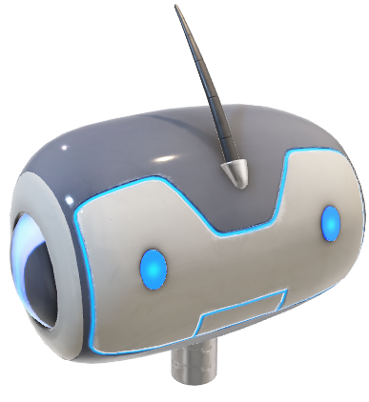
AI Interior generation using:
1.5_SD_inpaint
ControlNet
V2_Depth Model
Product demo by mitadru Datta

Slide 2
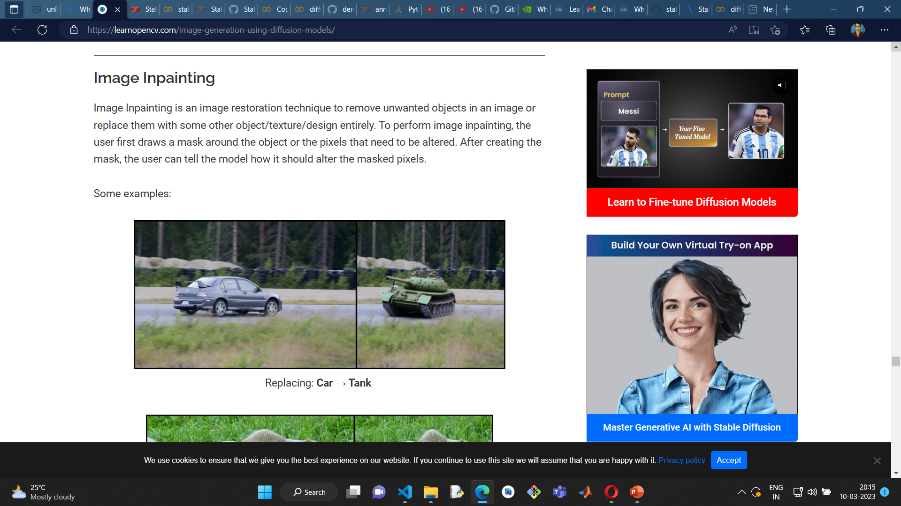
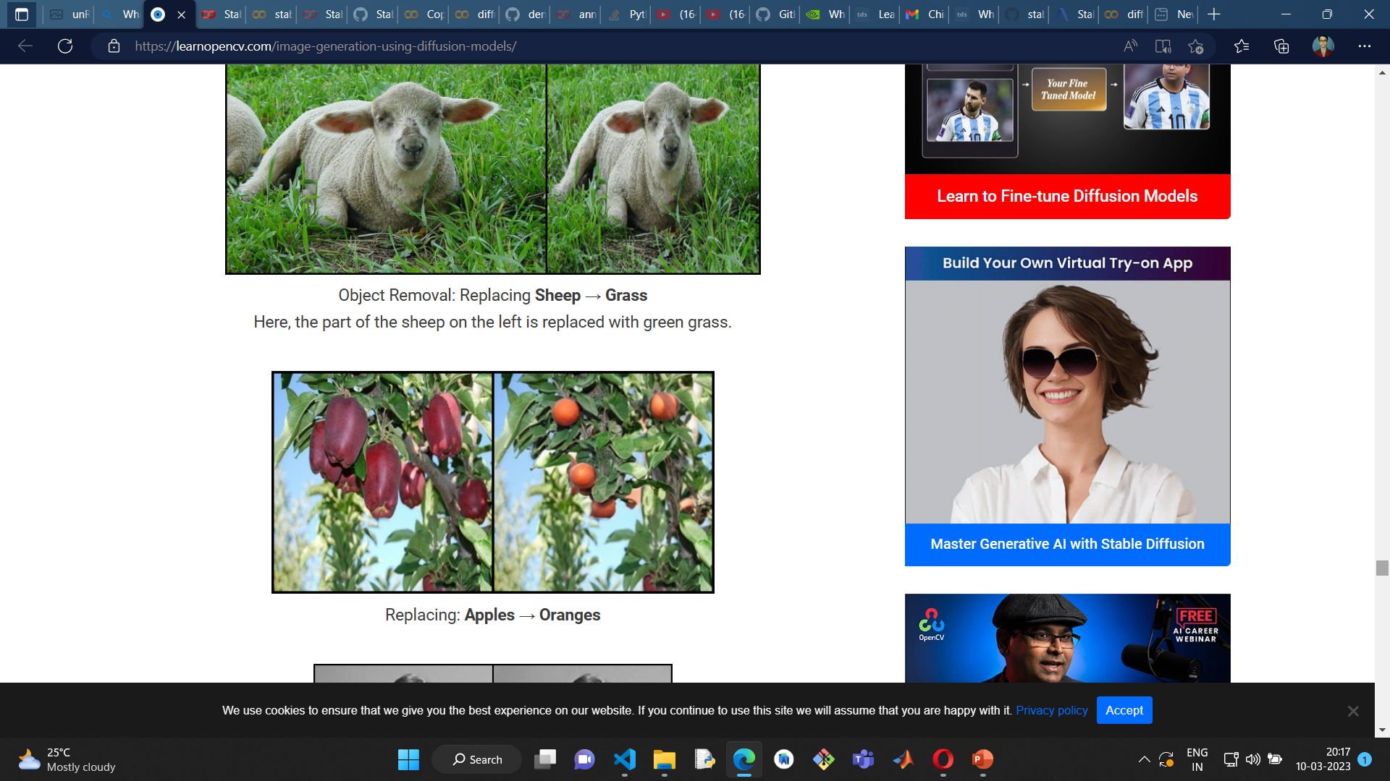
IMAGE INPAINTING
Image Inpainting is an image restoration technique to remove unwanted objects in an image or replace them with some other object/texture/design entirely. To perform image inpainting, the user first draws a mask around the object or the pixels that need to be altered. After creating the mask, the user can tell the model how it should alter the masked pixels.
Source: Introduction to Diffusion Models for Image Generation - A Comprehensive Guide (learnopencv.com)

Slide 3
Inpainting parameters
Denoising Strength:
Denoising strength controls how much respect the final image should pay to the original content. Setting it to 0 changes nothing. Setting to 1 you got an unrelated image. Set to a low value if you want small change and a high value if you want big change. 0.75 is usually a good starting point. Decrease if you want to change less
CFG Scale:
The Classifier Free Guidance scale is a parameter to control how much the model should respect your prompt.
1 – Mostly ignore your prompt. 3 – Be more creative. 7 – A good balance between following the prompt and freedom. 15 – Adhere more to the prompt. 30 – Strictly follow the prompt.

Slide 4
Inpainting parameters
Masked content:
Masked content controls how the masked area is initialized.
Fill: Initialize with a highly blurred of the original image.
Original: Unmodified.
Latent noise: Masked area initialized with fill and random noise is added to the latent space.
Latent nothing: Like latent noise except no noise is added to the latent space.
Seed:
Make sure to generate a few images at a time so that you can choose the best ones. Set the seed to -1 so that every image is different.
Mask Blur:
This Scale helps to decide how much we want the inpainted portion to mix with the surroundings. 0 means completely separate from the background and a high value meaning almost indistinguishable from the background.

Slide 5
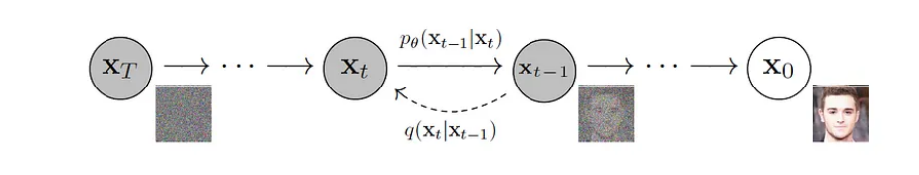
SO we ARe basically doing this:
Diffusion Models have recently showed a remarkable performance in Image Generation tasks and have superseded the performance of GANs on several tasks such as Image Synthesis.
This is due to the ability of the Diffusion Models to preserve the semantic structure of the data.
Source: Introduction to Diffusion Models for Image Generation - A Comprehensive Guide (learnopencv.com)

Slide 6
What is controlnet?
ControlNet is an extension to the Stable Diffusion model that gives users an extra layer of control when it comes to img2img processing.
The main idea behind ControlNet is to use additional input conditions that tell the model exactly what to do. With ControlNet, users can control the output to further match an original source image, making it more versatile and applicable to many different use cases.
ControlNet is not a standalone model, but rather an extension that can be added to any Stable Diffusion model. ControlNet models come in two forms: blocked and trainable.
The blocked form keeps the capabilities of the production-ready diffusion model, while the trainable variant can learn new conditions for picture synthesis by fine-tuning with tiny data sets.
Source: ControlNet Extension for Stable Diffusion - How Does It Work? - Easy With AI

Slide 7
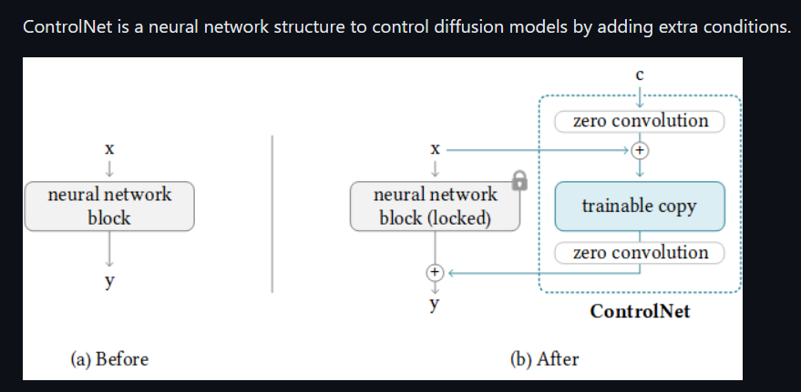
Controlnet – The working
It copies the weights of neural network blocks into a "locked" copy and a "trainable" copy.
The "trainable" one learns your condition. The "locked" one preserves your model.
Thanks to this, training with small dataset of image pairs will not destroy the production-ready diffusion models.
The "zero convolution" is 1×1 convolution with both weight and bias initialized as zeros.
Before training, all zero convolutions output zeros, and ControlNet will not cause any distortion.
No layer is trained from scratch. You are still fine-tuning. Your original model is safe.
This allows training on small-scale or even personal devices.
Source: lllyasviel/ControlNet: Let us control diffusion models! (github.com)

Slide 8
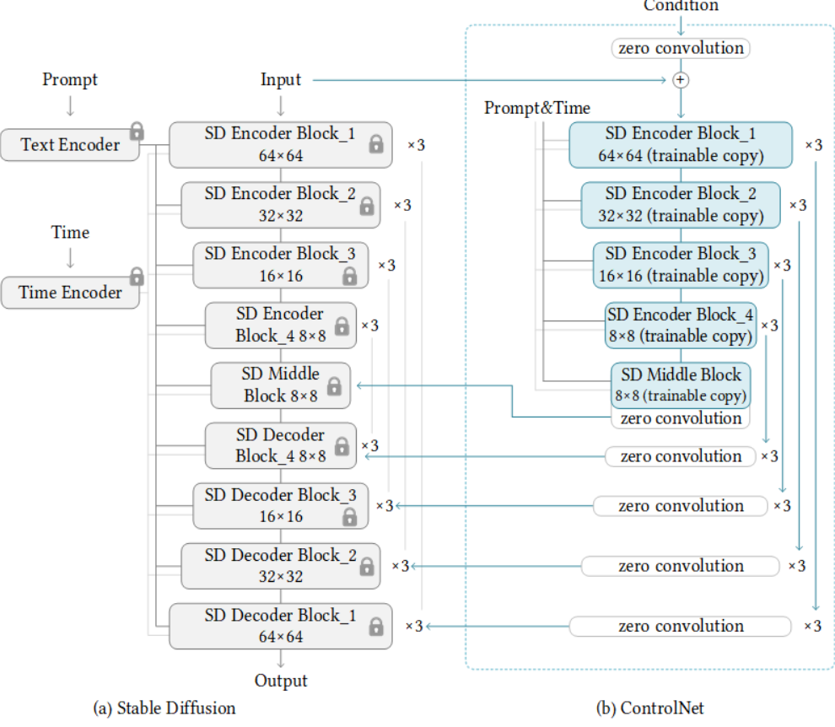
Controlnet – The working ii
In this way, the ControlNet can reuse the SD encoder as a deep, strong, robust, and powerful backbone to learn diverse controls. Many evidences validate that the SD encoder is an excellent backbone.
Note that the way we connect layers is computational efficient. The original SD encoder does not need to store gradients (the locked original SD Encoder Block 1234 and Middle). The required GPU memory is not much larger than original SD, although many layers are added. Great!
Source: lllyasviel/ControlNet: Let us control diffusion models! (github.com)

Slide 9
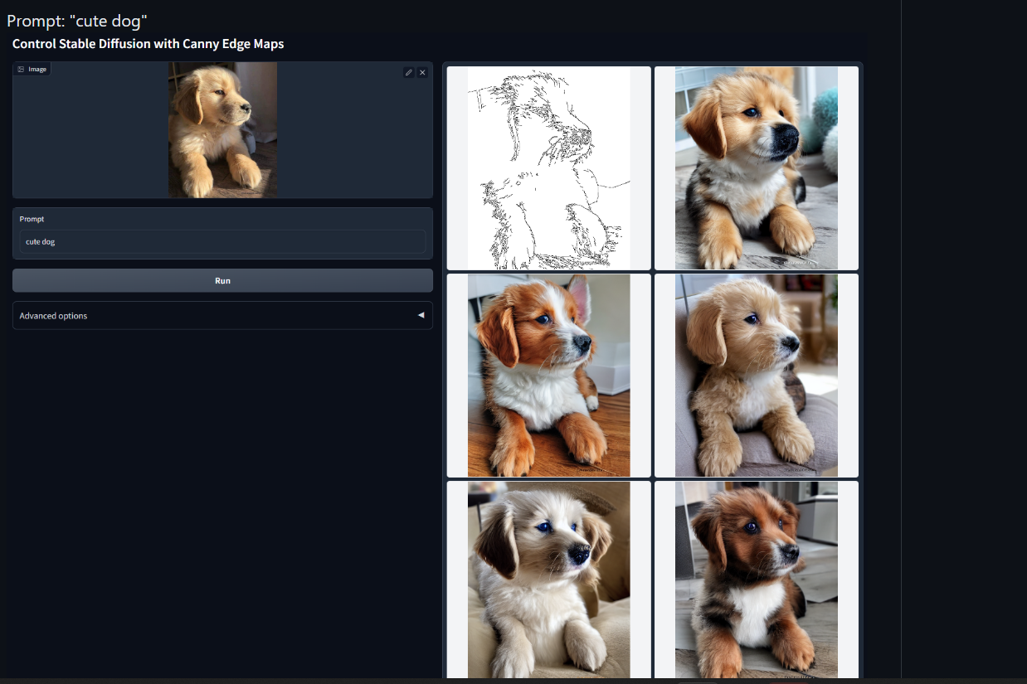
Canny edge Variant
Source: lllyasviel/ControlNet: Let us control diffusion models! (github.com)

Slide 10
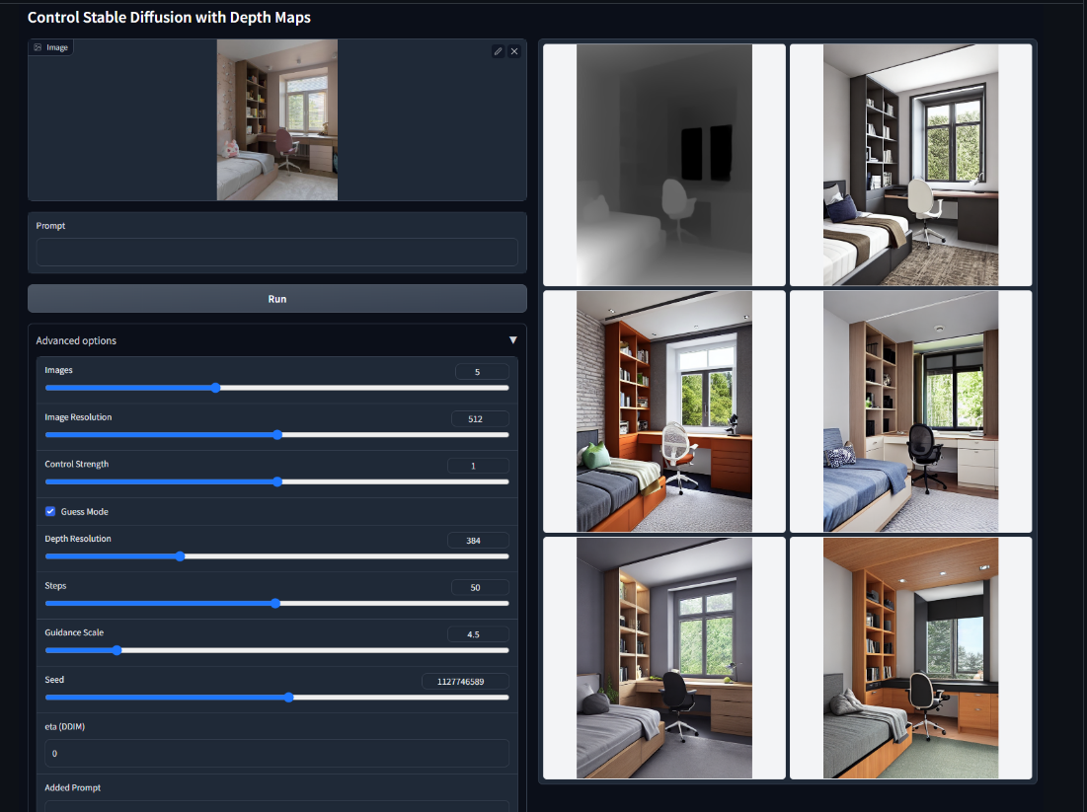
Depth Variant
Source: lllyasviel/ControlNet: Let us control diffusion models! (github.com)

Slide 11
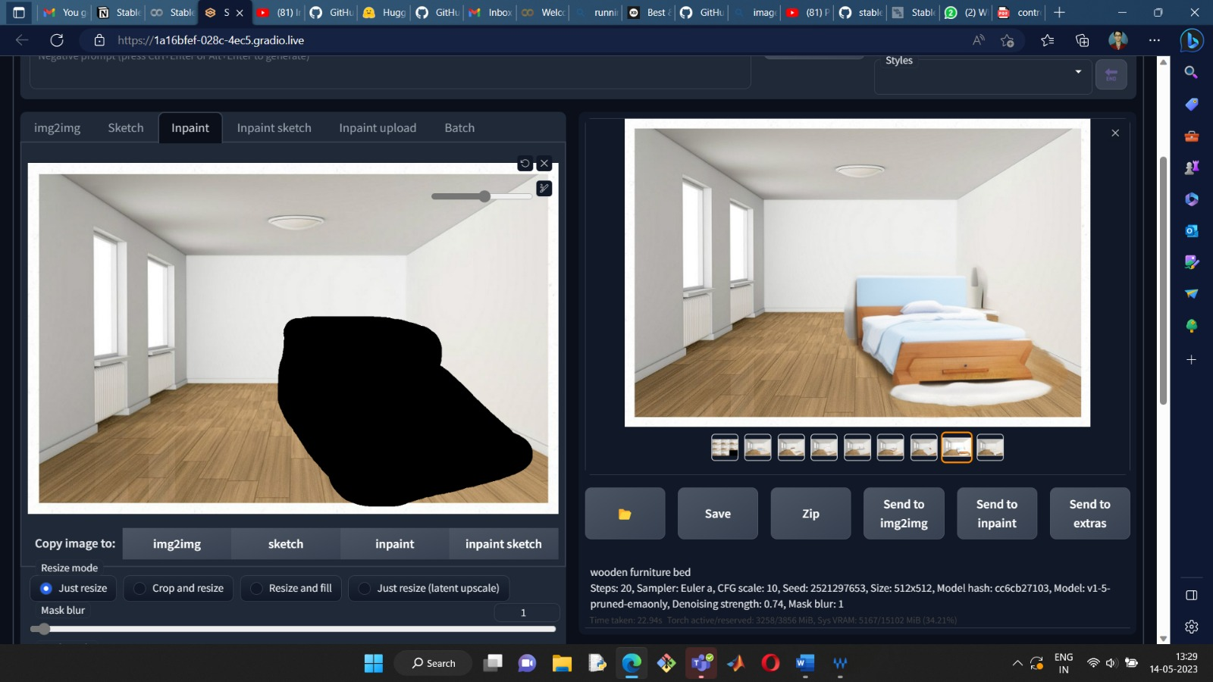

Slide 12
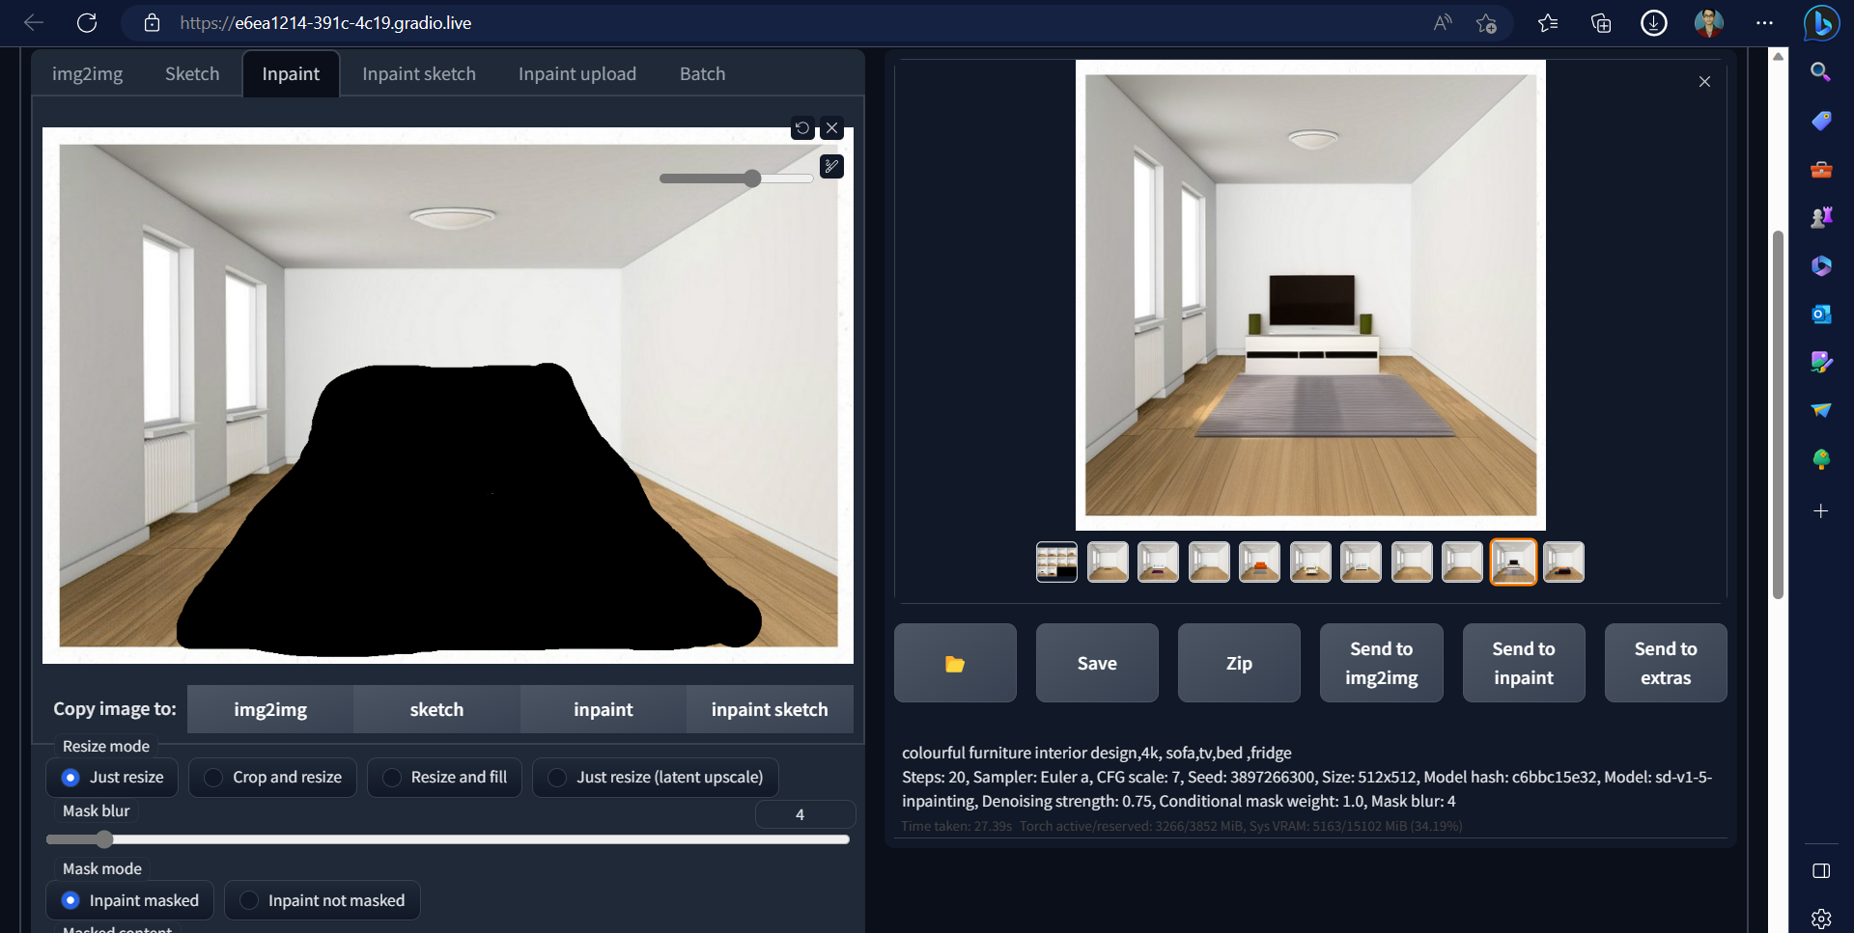

Slide 13
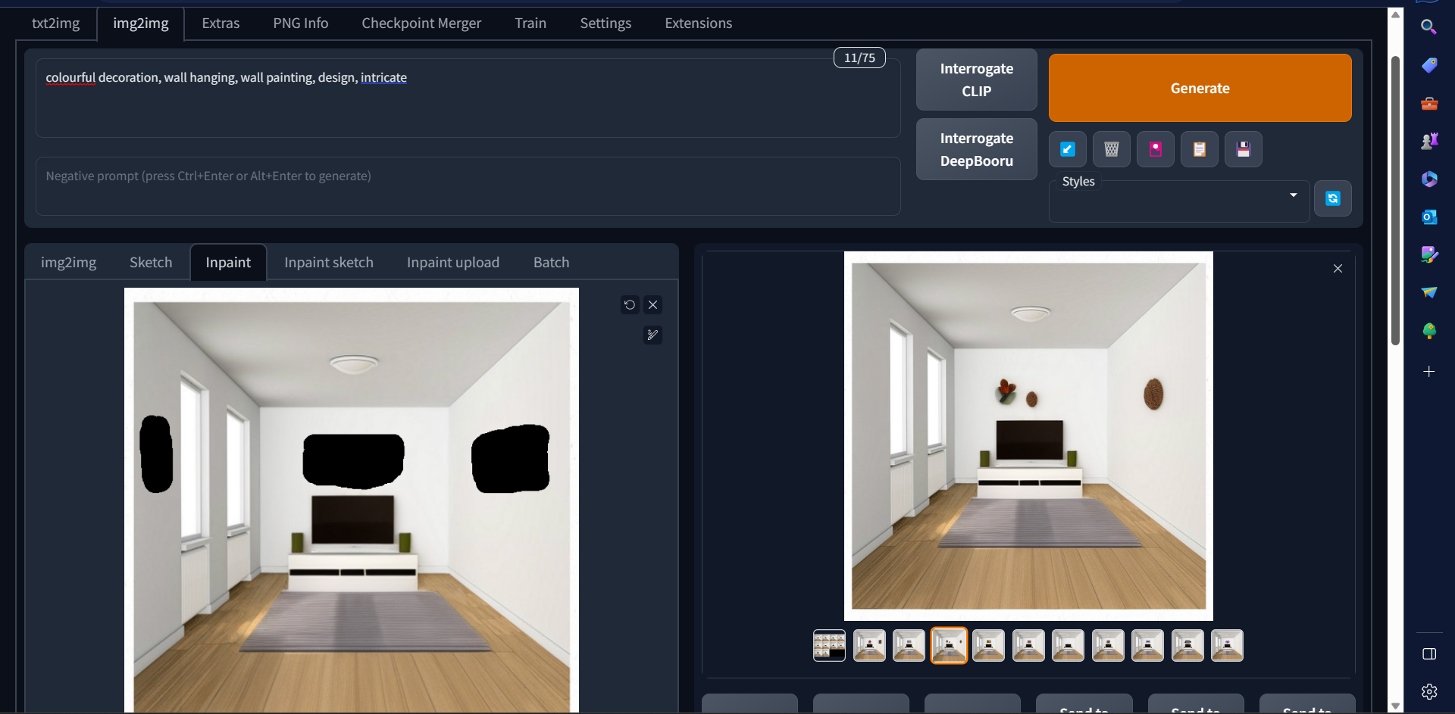
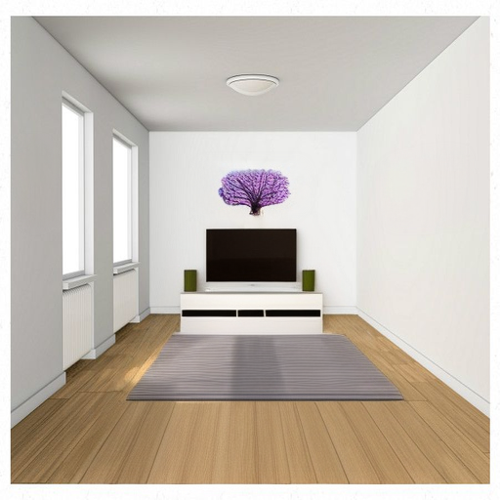
Another idea is to use multiple rounds of inpainting

Slide 14
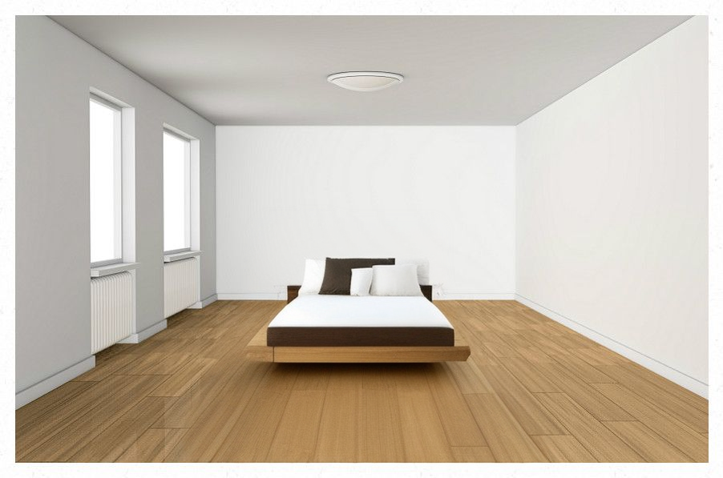

Slide 15
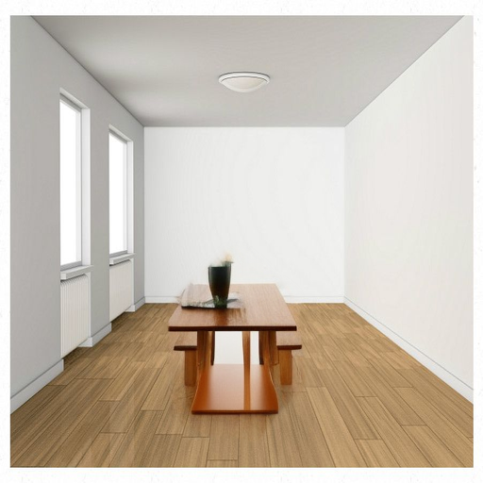
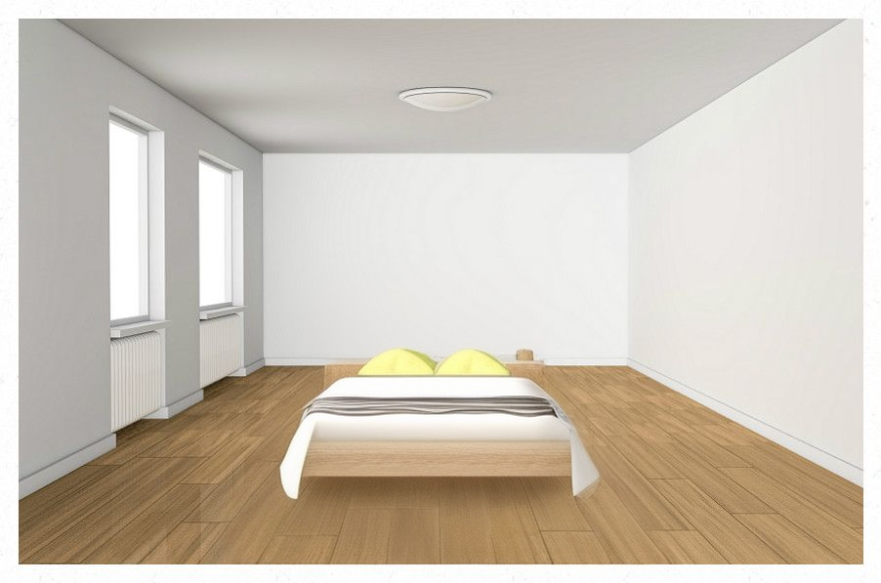

Slide 16
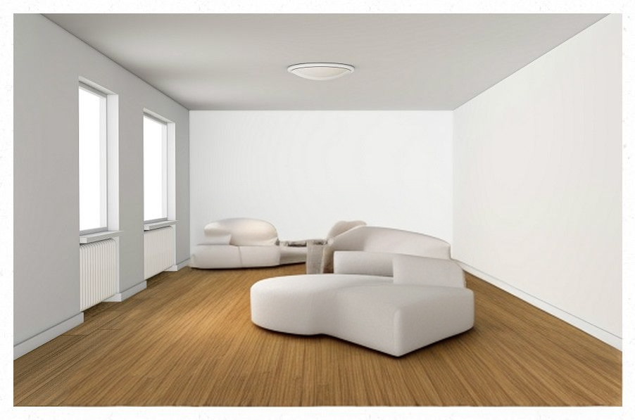
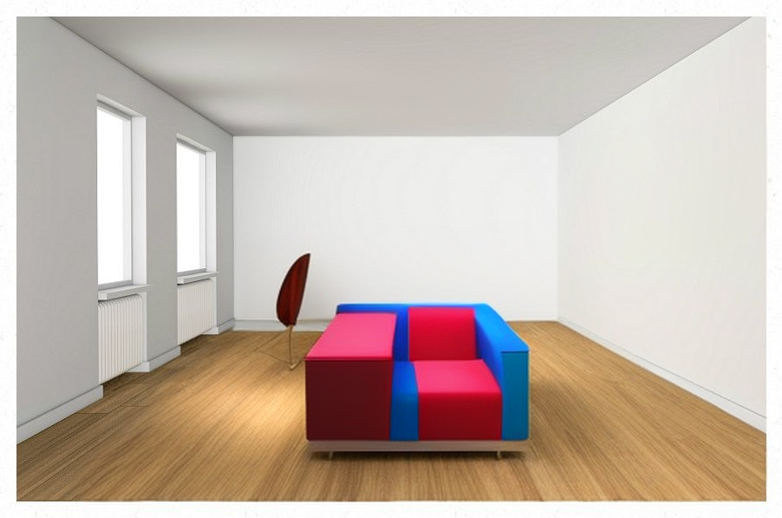

Slide 17
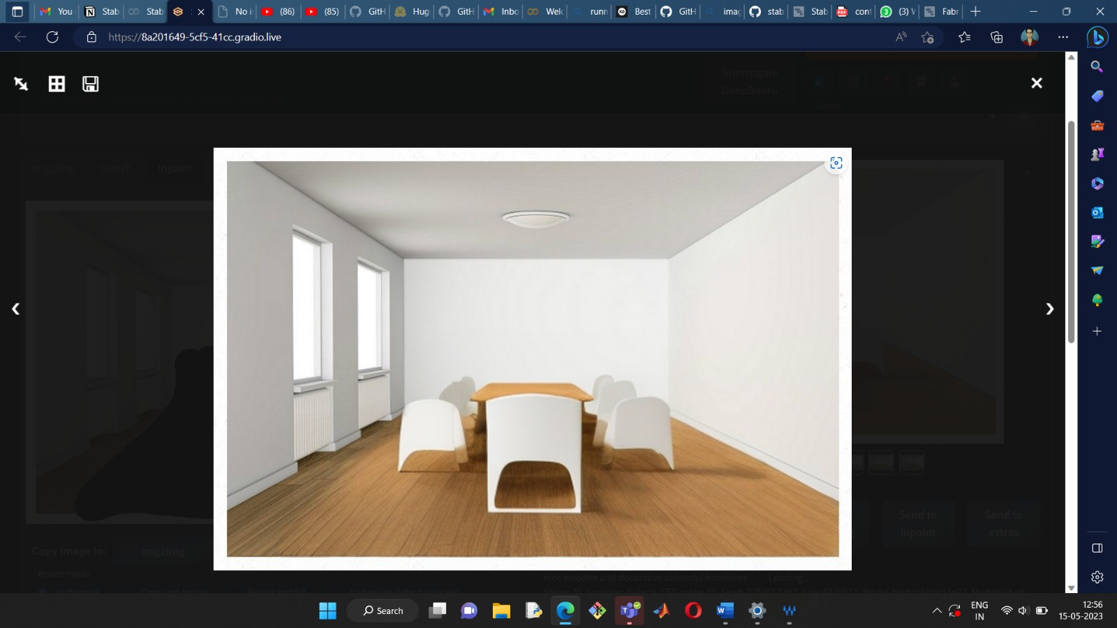
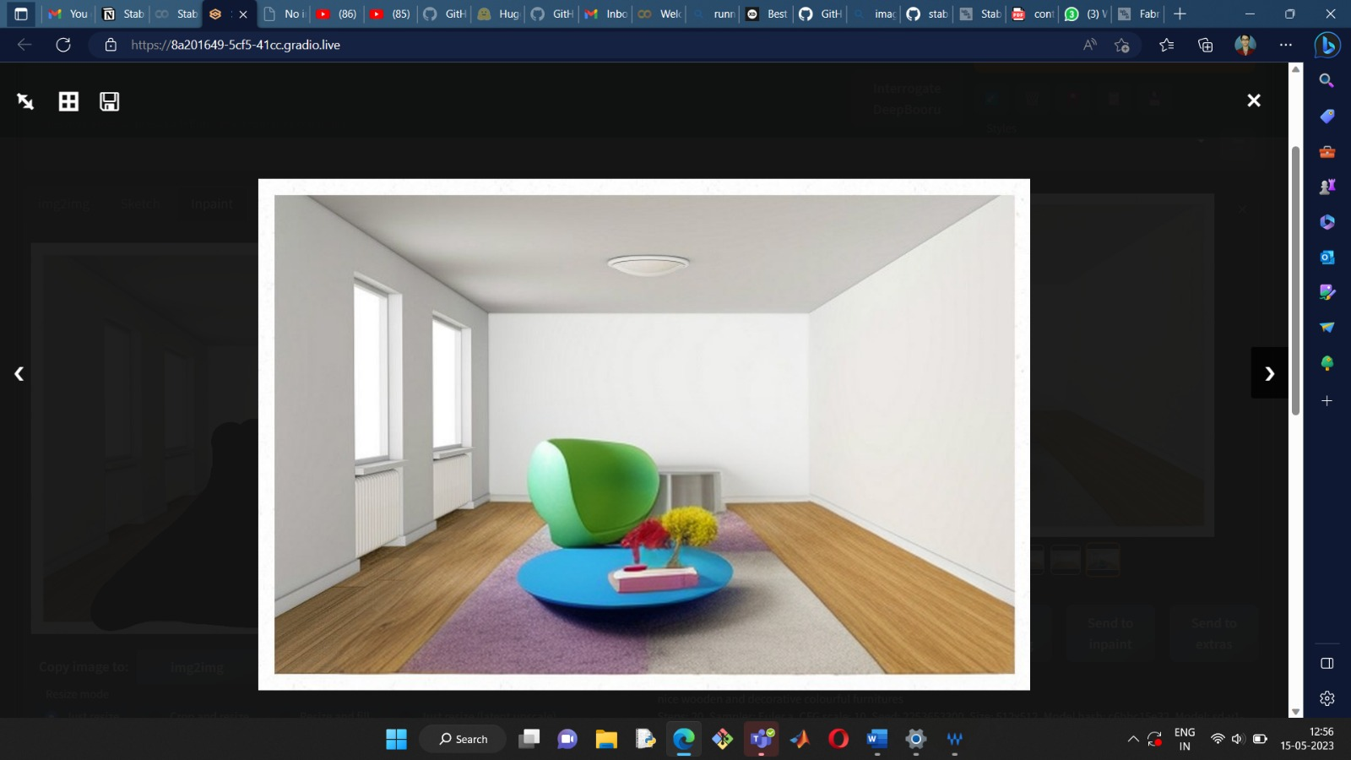
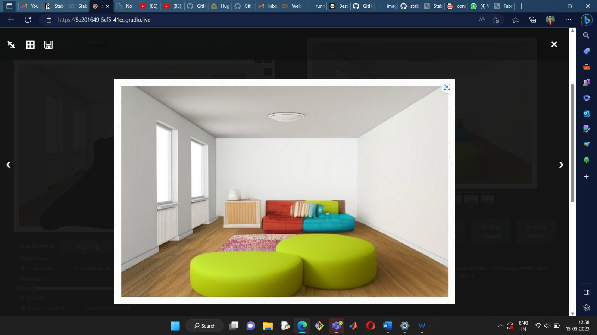

Slide 18
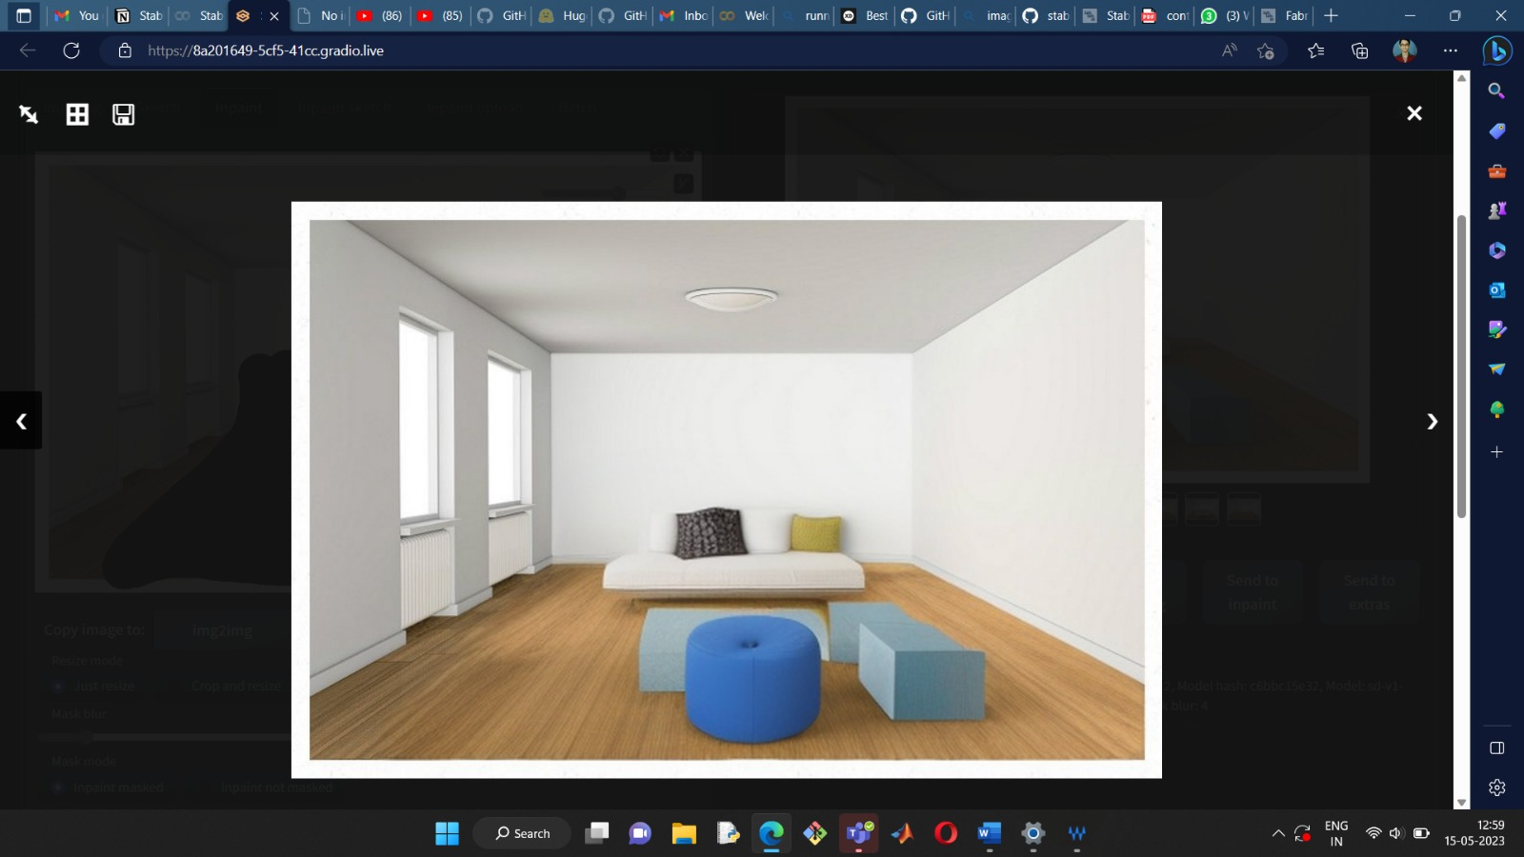
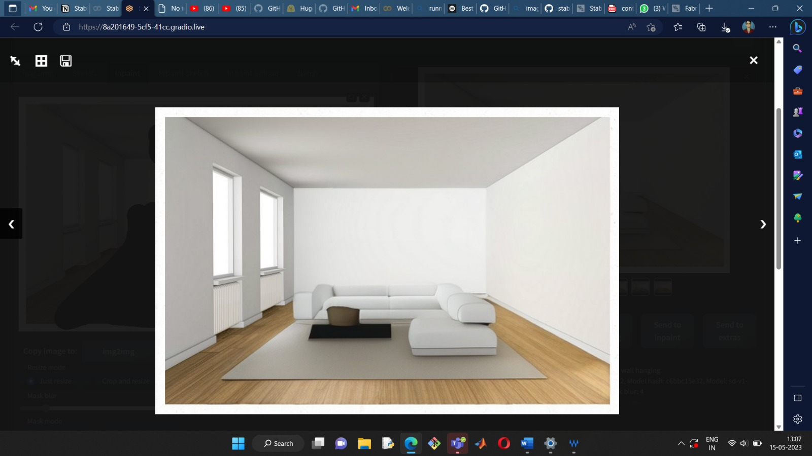

Slide 19
Now, lets say I like this model:
So let us try to generate more desiGns of the same model

Slide 20
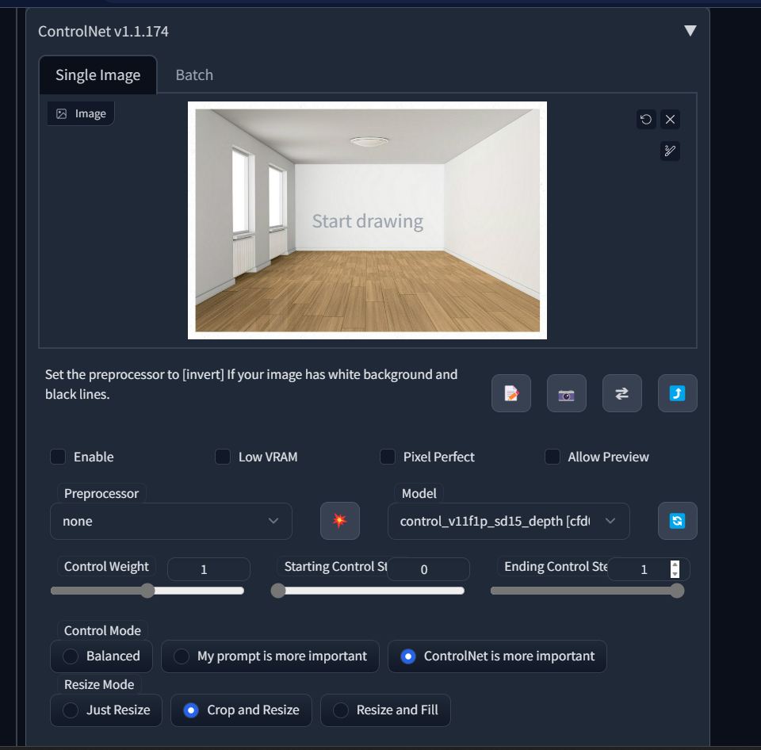
Using the controlnet depth option

Slide 21
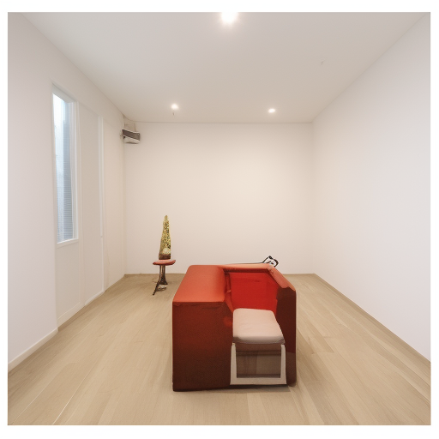
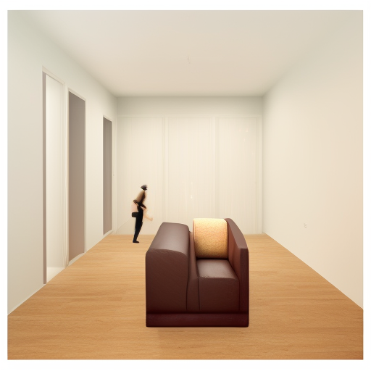
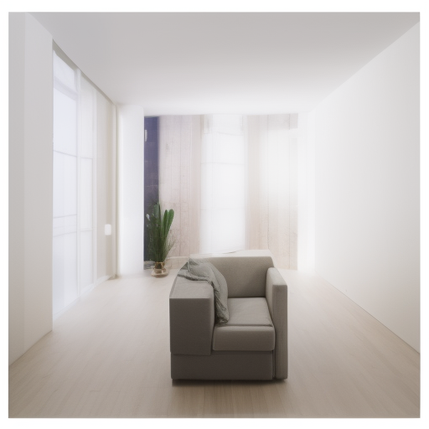
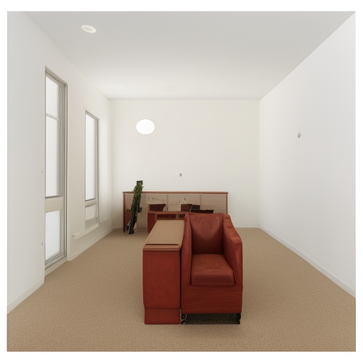
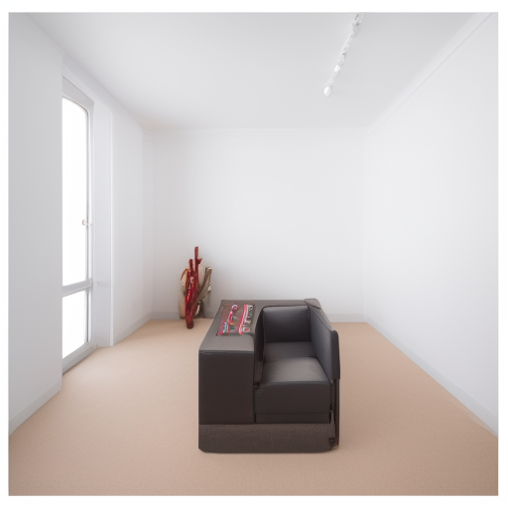

Slide 22
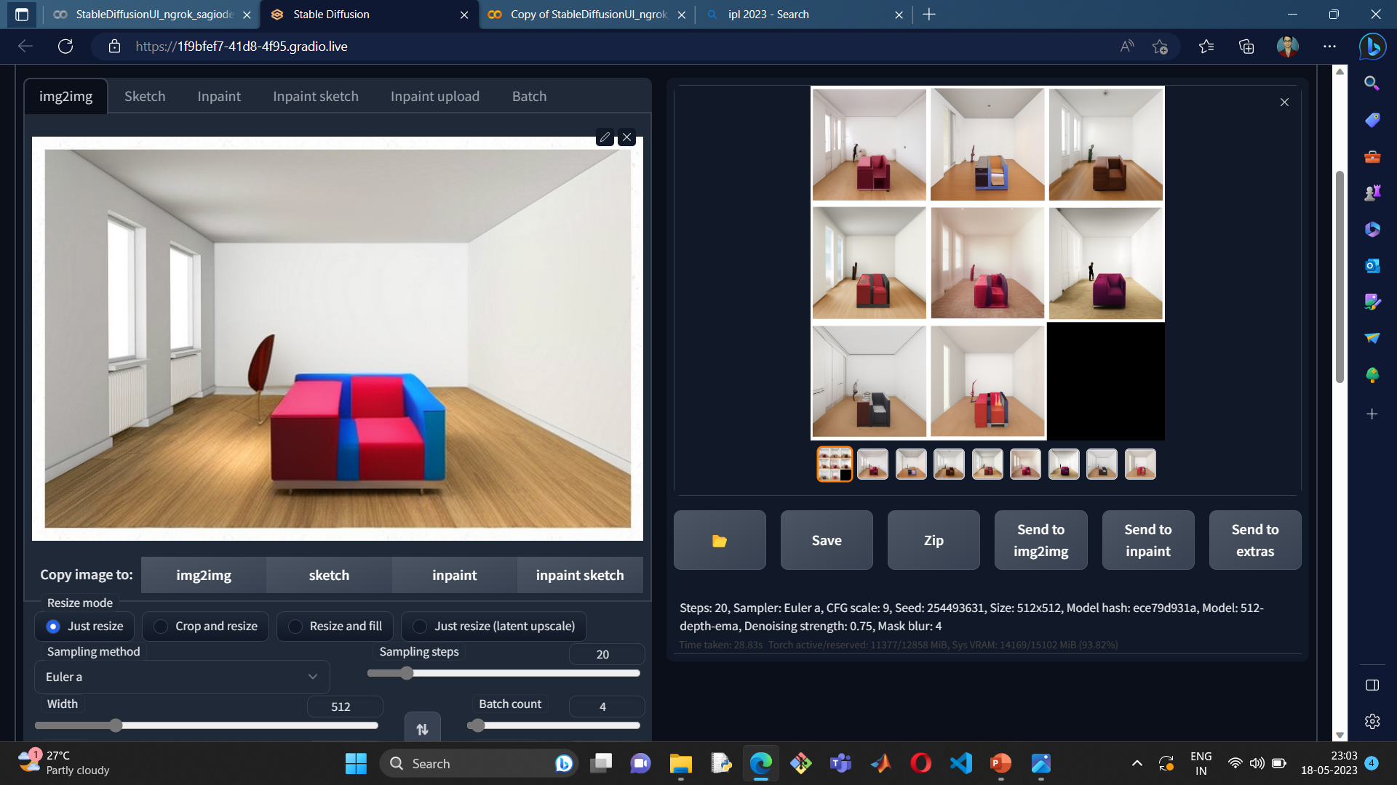

Slide 23
Similarly, we can generate variants of other models…

Slide 24
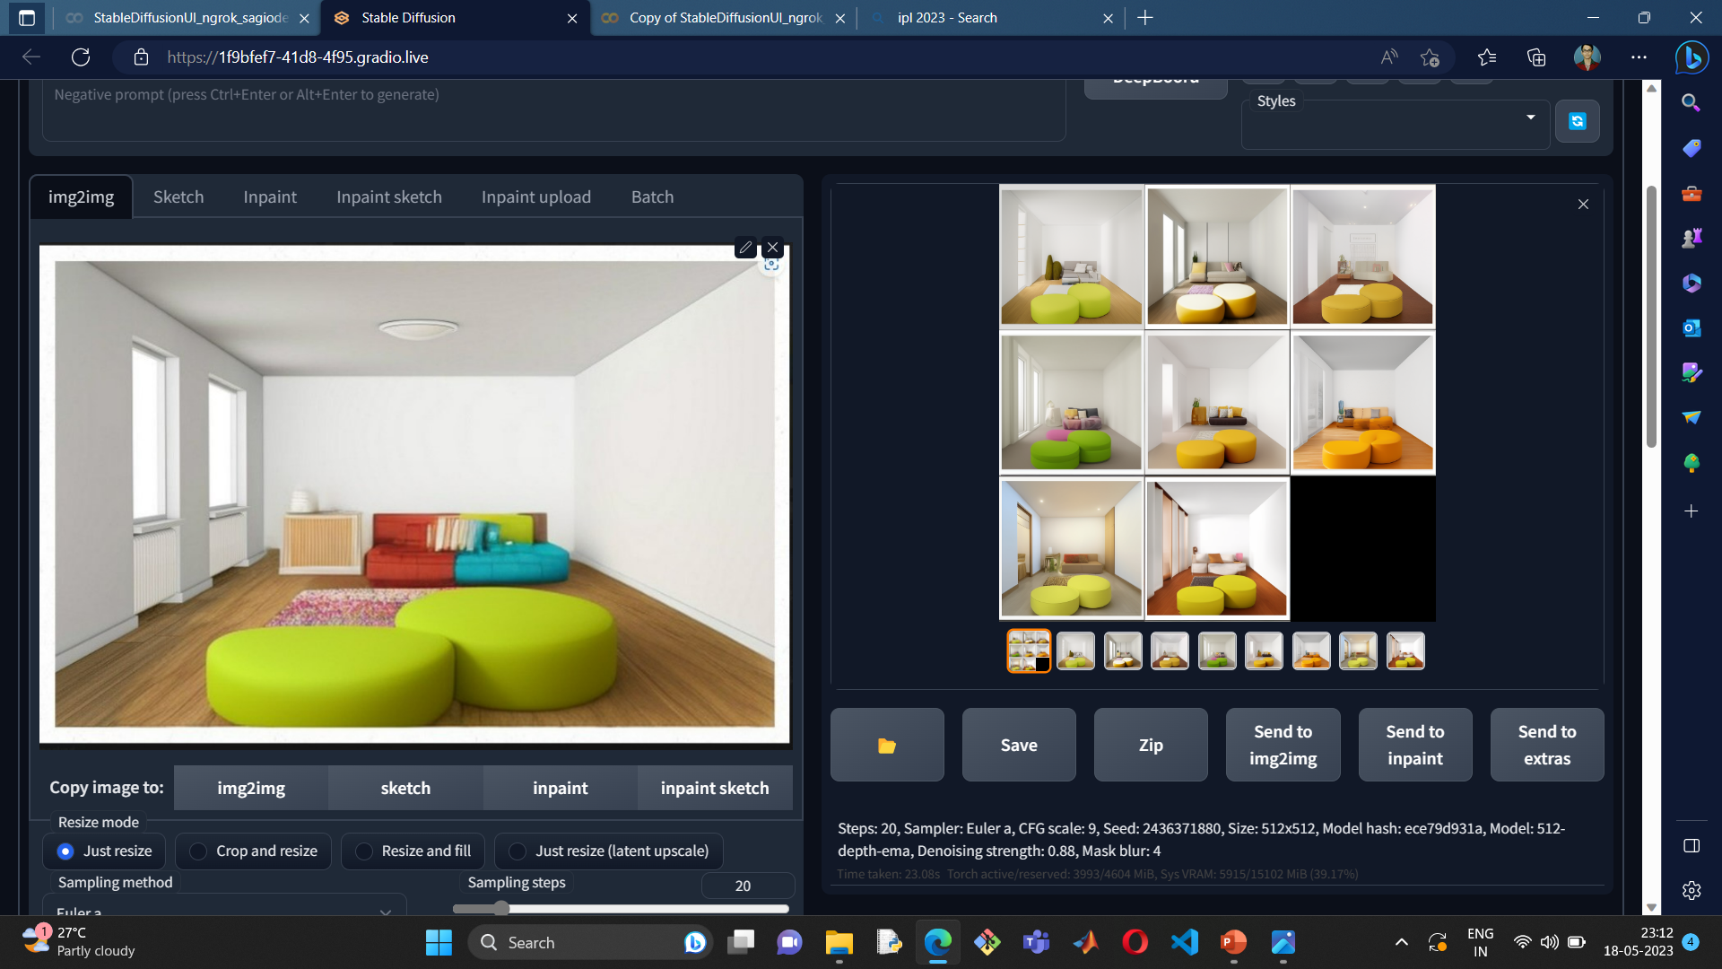

Slide 25
